Slide 1
NO SQL Basics
Lesson 01

Slide 2
Evaluation Of NoSQL
Many enterprises are making the switch from decades old relational technology to NoSQL.
NoSQL technology is much better suited to address the demands of Big Data applications.
But the process of NoSQL database evaluation can be tricky and confusing.
The term “NoSQL” itself is too broad and meant to encapsulate any database that does not follow the relational model.
There are several categories of NoSQL databases and within each category there are several options
It’s hard to discern which among those are the best fit for your application requirements and allow for future support and growth within your enterprise.

Slide 3
Evaluation Of NoSQL
As you go about investigating the different options, there are several important criteria to mull over.
First is whether the database enjoys widespread adoption and support.
Does the database have a robust developer community and partner ecosystem? If so, then that is a good indicator of its potential for future growth and adoption within your organization.
Another aspect to consider is the applicability of the database to a broad variety of use cases. If the database technology is only good at satisfying one or two scenarios then you can expect it to eventually die on the vine, so to speak.
Notes:
Based on just these two criteria alone, MongoDB is the NoSQL database to consider for your modern, Big Data applications.
The most popular database with 10 million downloads and counting, MongoDB has a thriving developer community with thousands of certified professionals, and it consistently ranks as the most popular.
NoSQL database according to DB-Engines’ monthly rankings. Also, as a general purpose database you can successfully employ MongoDB to address many different use cases.

Slide 4
Evaluation Of NoSQL
In 2006 Google published BigTable paper.
In 2007 Amazon presented DynamoDB.
It didn’t take long for all these ideas to used in:
Several open source projects (Hbase, Cassandra) and
Other companies (Facebook, Twitter, …)
And now? Now, nosql-database.org lists more than
150 NoSQL databases.

Slide 5
Why NoSQL-What is NoSQL?
Stands for ‘Not Only SQL’.
Originally refers to “non SQL” or “non Relational” database.
Term coined by Carlo Strozzi in 1998.
Open Source.
No Rows-Columns / Tables.
No Predefined schema.
Eventually consistency rather than ACID property.
Distributed computing.
Unstructured and unpredictable data.
Prioritizes high scalability ,high availability and scalability.
Replication support .

Slide 6
Why NoSQL
Handles Schema Changes Well (easy development)
Solves Impedance Mismatch problem
Rise of JSON
python module: simplejson

Slide 7
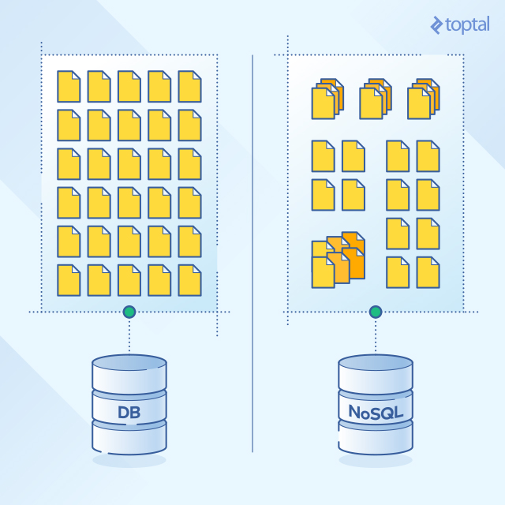
Why NoSQL
Reason for NoSQL are
Schema-less data storage
Quick data storage and traversal
Easier to program
Better performance
Easily distributed
Notes:
One key difference between NoSQL databases and traditional relational databases is the fact that NoSQL is a form of unstructured storage.
With the explosion of social media, user driven content has grown rapidly and has increased the volume and type of data that is produced, managed, analyzed, and archived. In addition, new sources of data, such as sensors, Global Positioning Systems or GPS, automated trackers, and other monitoring systems generate huge volumes of data on a regular basis.
To resolve the problems related to large-volume and semi-structured data, a class of new database products have emerged. These new classes of database products consist of column-based data stores, key/value pair databases, and document databases. Together, these are called NoSQL. The NoSQL database consists of diverse products with each product having unique sets of features and value propositions.

Slide 8
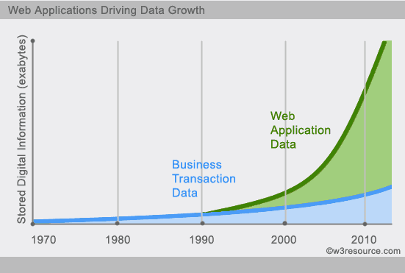
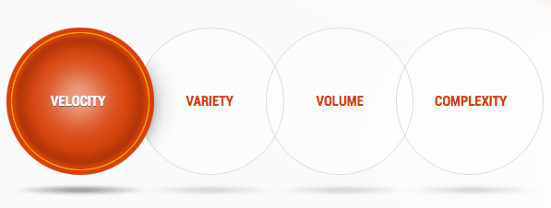
Why NoSQL

Slide 9
Why NoSQL-Example 1
Social Network Graph
Each record: UserID1, UserID2
Separate records: UserID, first_name,last_name, age, gender,...
Task: Find all friends of friends of friends of ... friends of a given user

Slide 10
Why NoSQL-Example 2
Wikipedia Pages
Task: Retrieve all pages regarding athletics of Summer Olympic before 1950
Combination of structured and unstructured data
Large collection of documents

Slide 11
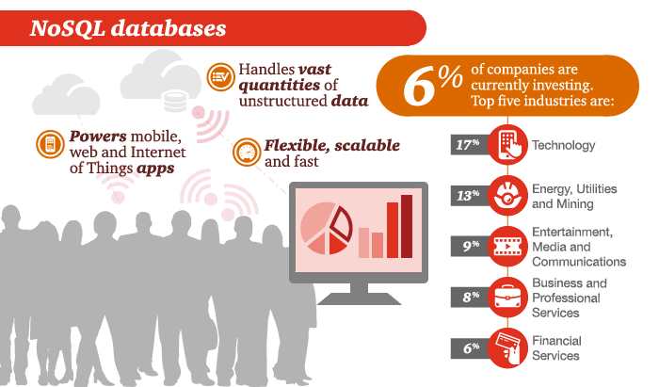
Why NoSQL - NOSQL Market

Slide 12
Pros and Cons of NoSQL Databases-Cons Of NoSQL
1. Not Mature
2. Less Support
3. Business Analytics And Intelligence
Notes:
1. Not Mature Rational models have been around for some time now compared to NoSQL models and as a result they have grown to be more functional and stable systems over the years.
2. Less Support Every business should be reassured that in case a key function in their database system fails, they will have unlimited competent support any time. All rational model vendors have gone the extra mile to provide this assurance and made it sure that their support is available 24 hours which is not a step yet guaranteed by NoSQL vendors.
3. Business Analytics And Intelligence NoSQL models were created because of the modern-day web 2.0 web applications in mind. And because of this, most NoSQL features are focused to meeting these demands ignoring the demands of apps made without these characteristics hence end up offering fewer analytic features for normal web apps.
Any businesses looking to implement NoSQL model needs to do it with caution, remembering the above mentioned pros and cons they posse in contrast to their rational opposites.

Slide 13
Pros and Cons of NoSQL Databases-Pros Of NoSQL
Flexible Scalability
Stores Massive Amounts Of Data
Database Maintenance
Economical
Notes:
1.Flexible Scalability Unlike rational database management model that is difficult to scale out when it come to commodity clusters NoSQL models make use of new nodes which makes them transparent for expansion. The model is designed to be used even with low cost hardware's. In this current world where outward scalability is replacing upwards scalability, NoSQL models are the better option.
2. Stores Massive Amounts Of Data Given the fact that transaction rates are rising due to recognition, huge volumes of data need to be stored. While rational models have grown to meet this need it is illogical to use such models to store such large volumes of data. However these volumes can easily be handled by NoSQL models
3. Database Maintenance The best rational models need the service of an expert to design, install and maintain. However, NoSQL models need much less expert management as it already has auto repair and data distribution capabilities, fewer administration and turning requirements as well as simplified data designs.
4. Economical Rational models require expensive proprietary servers and storage systems whereas NoSQL models are easy and cheap to install. This means that more data can be processed and stored at a very minimal cost.

Slide 14
NoSQL Vs Relational DB
Data models
Data structure
Scaling
Development model
Notes:
NoSQL databases differ from older, relational technology in four main areas:
Data models: A NoSQL database lets you build an application without having to define the schema first unlike relational databases which make you define your schema before you can add any data to the system. No predefined schema makes NoSQL databases much easier to update as your data and requirements change.
Data structure: Relational databases were built in an era where data was fairly structured and clearly defined by their relationships. NoSQL databases are designed to handle unstructured data (e.g., texts, social media posts, video, email) which makes up much of the data that exists today.
Scaling: It’s much cheaper to scale a NoSQL database than a relational database because you can add capacity by scaling out over cheap, commodity servers. Relational databases, on the other hand, require a single server to host your entire database. To scale, you need to buy a bigger, more expensive server.
Development model: NoSQL databases are open source whereas relational databases typically are closed source with licensing fees baked into the use of their software. With NoSQL, you can get started on a project without any heavy investments in software fees upfront.

Slide 15
NoSQL Vs Relational DB
Feature | NoSQL Databases | Relational Databases
Performance | High | Low
Reliability | Poor | Good
Availability | Good | Good
Consistency | Poor | Good
Data Storage | Optimized for huge data | Medium sized to large
Scalability | High | High (but more expensive)
Notes:
Most NoSQL databases do not support reliability features(ACID) which are natively supported by relational database System.
This also means that NoSQL databases, which don’t support those features, trade consistency for performance and scalability.

Slide 16
CAP Theorem
Consistency
This means that the data in the database remains consistent after the execution of an operation. For example after an update operation all clients see the same data.
Availability
This means that the system is always on (service guarantee availability), no downtime.
Partition Tolerance
This means that the system continues to function even the communication among the servers is unreliable, i.e. the servers may be partitioned into multiple groups that cannot communicate with one another.

Slide 17
Data store types-NO SQL Databases Types
Three Popular NoSQL Design types :
Key / Value Store
Document Database
Graph Database
Notes:
Most NoSQL databases do not support reliability features(ACID) which are natively supported by relational database System.
This also means that NoSQL databases, which don’t support those features, trade consistency for performance and scalability.

Slide 18
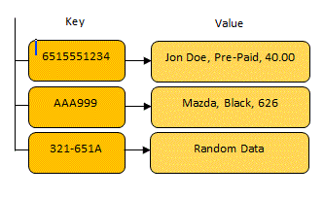
NO SQL Databases Types-Key / value store type
Key / Value store databases allow for
values to be associated with and looked
up by a key.
Keys can be associated with more than
one value.
Some implementations of the key value store provide caching mechanisms, which greatly enhance their performance.
Data is stored in a form of a string, JSON, or BLOB (Binary Large Object).
The most famous NoSQL database that is built on a key value store is Amazon’s Dynamo DB.
Notes:
Most NoSQL databases do not support reliability features(ACID) which are natively supported by relational database System.
This also means that NoSQL databases, which don’t support those features, trade consistency for performance and scalability.

Slide 19
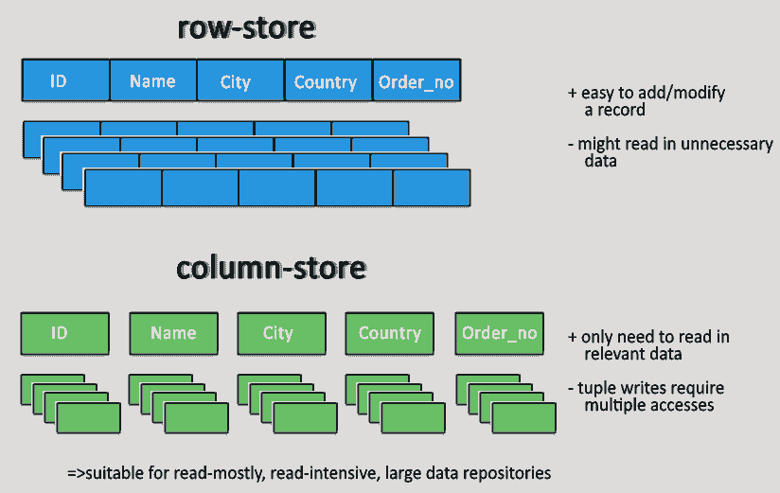
NO SQL Databases Types-Key / value store type
Key Value Stores

Slide 20
NO SQL Databases Types-Document data store
Document databases store information in documents such as JSON or XML.
A collection of documents
Data in this model is stored inside documents.
A document is a key value collection where the key allows access to its value.
Documents are not typically forced to have a schema and therefore are flexible and easy to change..
Notes:
Most NoSQL databases do not support reliability features(ACID) which are natively supported by relational database System.
This also means that NoSQL databases, which don’t support those features, trade consistency for performance and scalability.

Slide 21
NO SQL Databases Types-Document data store
Documents can contain many different key-value pairs, or key-array pairs, or even nested documents.
Example of Document Oriented databases : MongoDB, CouchDB etc.
.
Notes:
Most NoSQL databases do not support reliability features(ACID) which are natively supported by relational database System.
This also means that NoSQL databases, which don’t support those features, trade consistency for performance and scalability.

Slide 22
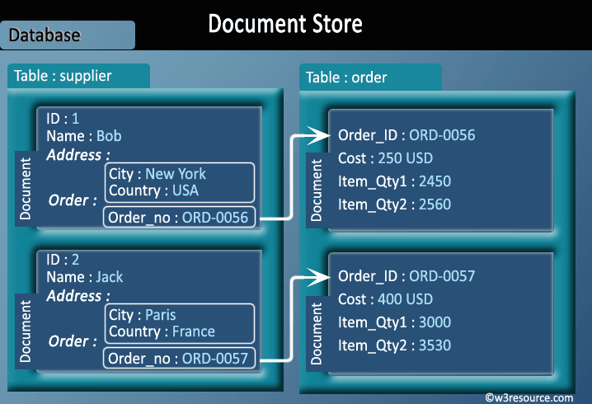
NO SQL Databases Types-Document data store
Notes:
Most NoSQL databases do not support reliability features(ACID) which are natively supported by relational database System.
This also means that NoSQL databases, which don’t support those features, trade consistency for performance and scalability.

Slide 23
NO SQL Databases Types-Document data store
Document Store

Slide 24
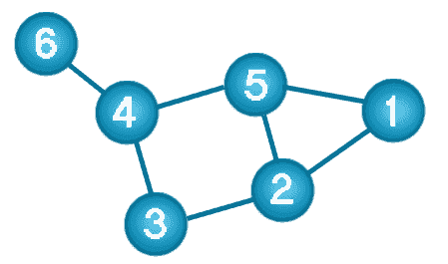
NO SQL Databases Types-Graph data store type
Graph databases store all of their information in nodes (vertices) and edges.
Each node represents an entity (such as a student or business) and each edge represents a connection or relationship between two nodes.
Relationship information about
nodes is stored in the edges.
Graph traversal is how you “query”
the database.
Example of Graph databases : OrientDB
Notes:
Most NoSQL databases do not support reliability features(ACID) which are natively supported by relational database System.
This also means that NoSQL databases, which don’t support those features, trade consistency for performance and scalability.

Slide 25
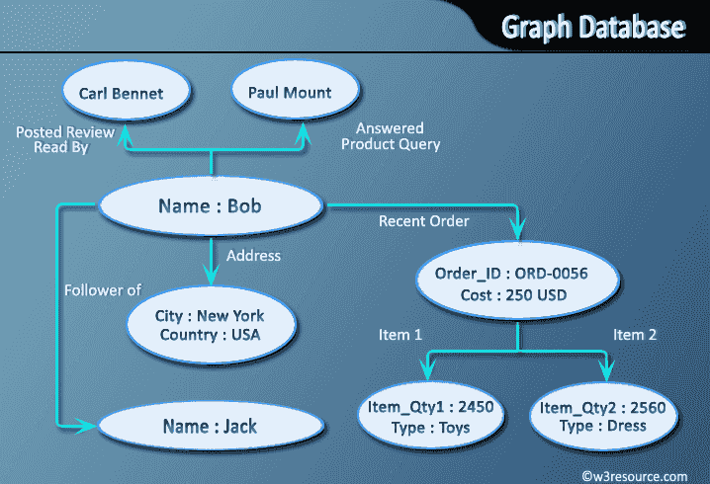
NO SQL Databases Types-Graph data store type
Graph Database

Slide 26
Different NoSQL DBMS
Key-value
Graph database
Document-oriented
Column family
Notes:
Huge quantity of data => Distributed systems => expensive joins =>
New fields, new demands (graphs) =>
Different data strucutres:
Simplier or more specific

Slide 27
Production Deployment
Google
Facebook
Mozilla
Adobe
Foursquare
LinkedIn
Digg
McGraw-Hill Education
Vermont Public Radio

Slide 28
Summary
What is NOSQL database
Advantages of NOSQL
Why MongoDB
MongoDB Document database
MongoDB data model
Mongo Shell
Establishing Connection
Understand about Collection, document and fields

